Slide 1

GSA SmartPay Purchase Management Essentials Rebekah Knouse Perillo
Notes:
Hello. My name is Rebekah Knouse Perillo and I am a Business Management Specialist with GSA’s Center for Charge Card Management.
Today, I will be presenting the GSA SmartPay Purchase Management Essentials course. This is a basic introduction about GSA SmartPay’s purchase business line geared towards newer A/OPCs.
For more seasoned charge card management professionals, we are also offering the Advanced Purchase Management course during this year’s forum. So, please try to check out that class if your schedule allows.
.
Just a quick reminder that all of the forum courses are available on-demand through the end of July if you’re not able to attend the live sessions. You receive CLP credit when you attend live classes and when you attend on-demand classes.
We have quite a bit of information to review today, so let’s go ahead and get started!

Slide 2
Overview
Notes:
First, we’ll start with some high level information about the GSA SmartPay program.

Slide 3
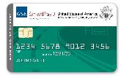
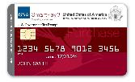
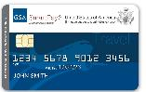
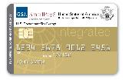
GSA SmartPay Program Overview
More than 560 Federal government agencies/ organizations can access charge card products and services through the GSA SmartPay 3 Master Contract.
Over 6.5 million accounts.
GSA SmartPay Master Contract awarded in 1998.
Notes:
The GSA SmartPay Program is the largest government charge card and related payment solutions program in the world. The program has over 6.5 million Purchase, Travel, Fleet, and Integrated accounts and supports more than 560 agencies/organizations across the federal government.
Since the award of the initial GSA SmartPay Master Contract in 1998, the GSA SmartPay Program has provided convenient, efficient, and effective payment solutions for the Federal Government, Tribes, and Tribal Organizations.

Slide 4
GSA SmartPay Program Overview
Federal government agencies/organizations issue task orders against the GSA SmartPay 3 Master Contract for charge card products and services from one of two contractor banks: Citibank and U.S. Bank.
Agencies/organizations pay no direct fees for using the GSA SmartPay Program.
Agencies/organizations have the opportunity to earn refunds.
Notes:
For the GSA SmartPay 3 program, also called SP3, there are two contractor banks: Citibank and U.S. Bank.
Agencies pay no direct fees for using the GSA SmartPay program.
And, one of the very best parts of the program for agencies, is the opportunity to earn refunds, which we’ll talk about in a bit later on.

Slide 5
Banks and Brands
GSA SmartPay Account Service Providers
Citibank
Mastercard
Visa
WEX (Fleet)
U.S. Bank
Mastercard
Visa
Voyager (Fleet)
Notes:
Again, there are two contractor banks for SP3 – Citibank and U.S. Bank. The brands that work with Citibank are Mastercard, Visa, and for fleet transactions, Wright Express (also known as WEX). The brands that work with U.S. Bank are Mastercard, Visa, and for fleet transactions, Voyager.

Slide 6
GSA SmartPay Master Contract
Fixed price, IDIQ contract.
Maximum base period for the initial order is 4 years with three 3 year options (13 years).
The 4-year base period ended on November 29, 2022.
Agency awarded a task order to a GSA SmartPay contractor bank and to a brand.
Download a copy at smartpay.gsa.gov.
We are here!
2018 – 2022
(4-year base period)
2022 – 2025
(3-year option)
2025 – 2028
(3-year option)
2028 – 2031
(3-year option)
Notes:
Through contracts with Citibank and U.S. Bank, the GSA SmartPay program enables agencies/organizations across the Federal Government to obtain payment solutions to support mission needs.
The GSA SmartPay Master Contract, administered by GSA, is a fixed price, indefinite delivery/ indefinite quantity (or IDIQ) type contract.
The maximum base period for the initial order is four years with three, three-year options. The base period just ended on November 29, 2022. So, we are now in our first option.
To participate in the program, Agencies/Organizations must be eligible to issue a task order against the GSA SmartPay Master Contract.
So, your agency awarded a task order to one of the GSA SmartPay contractor banks and then selected to use either Visa or Mastercard branded accounts.
No matter which path your agency chose, it is through the task order, that accounts are set-up and managed by Agency/Organization Program Coordinators (or A/OPCs). The A/OPC has access to the banks’ Electronic Access System (EAS) and also works with the banks to resolve issues and answer questions. We’ll talk more about the A/OPC role in a bit.
Understanding the terms and conditions of the GSA SmartPay Master Contract is important to performing your role as a program coordinator. The terms and conditions of the Master Contract identify specific contractual requirements that the GSA SmartPay program has with the banks.
The GSA SmartPay Master Contract can be viewed on the GSA SmartPay website – which is smartpay.gsa.gov. Download a copy of the Master Contract and review relevant clauses and sections that pertain to the GSA SmartPay purchase program as well as the GSA SmartPay program in general.
Also, during the forum, we are offering a GSA SmartPay 3 Master Contract Basics course, so that may be helpful to attend. Please keep in mind that all forum courses are available on-demand through the end of July 2023.

Slide 7
Statistics
Notes:
Let’s take a quick look at some GSA SmartPay program statistics.

Slide 8
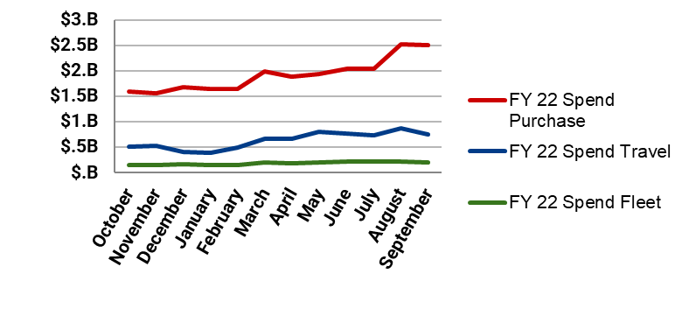
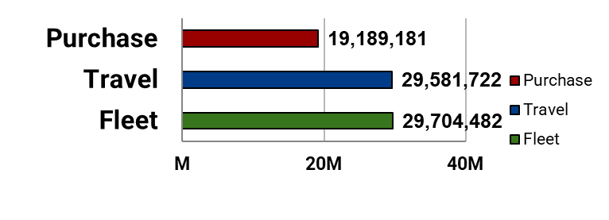
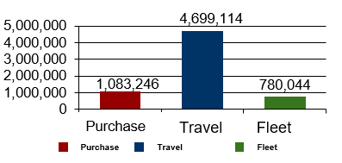
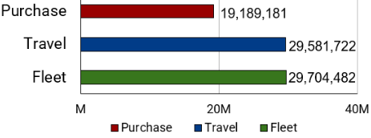
FY22 Program Statistics
Spend
Summary
Total Spend:
$32.8B
Total Transactions:
78.5M
12.4% vs. FY21.
12.9% vs. FY21.
Total Refunds:
$426.5M
Total Accounts:
6.56M
9.4% vs. FY21.
8.5% vs. FY21.
Transactions
Accounts
Notes:
First, we’ll look at the GSA SmartPay program overall, which includes all business lines (purchase, travel, integrated, and fleet). Then, we’ll review some purchase numbers separately.
So, here, you’ll see that the FY22 spend for the entire GSA SmartPay program overall was $32.8 billion dollars. This is up about 12% from FY21.
As far as refunds are concerned, as mentioned on a previous slide, total refunds were up in FY22, totaling over $426 million dollars. Again, these refunds go back to agencies to reinvest in their mission.
Transactions were up almost 13% in FY22, totaling over 78 million transactions.
And, total accounts were up about 8% in FY22, totaling 6.56 million accounts.
So, overall FY22 GSA SmartPay program numbers were very strong.

Slide 9
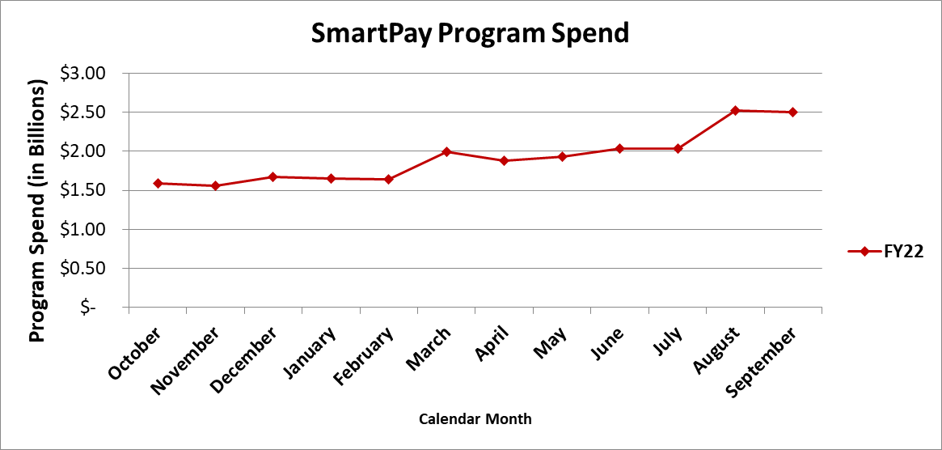
FY22 Purchase Spend
Purchase spend total $23.0B, 70% of total program spend ($32.8B).
Purchase | FY21 | FY22 | % Change
Spend | $22.0B | $23.0B | ▲ 4.7%
Transactions | 19.4M | 19.2M | ▼ -0.9%
Accounts | 987K | 1.1M | ▲ 9.8%
Agency | FY22 Spend | % of Purchase Spend
1. Department of Veteran Affairs | $13.6B | 59.1%
2. Department of Defense | $5.0B | 21.7%
3. Department of Justice | $831M | 3.6%
4. Department of Health and Human Services | $523M | 2.3%
5. Department of Interior | $519M | 2.2%
$23.0 Billion
Purchase Spend
Notes:
Now, let’s review some purchase numbers.
As mentioned before, the FY22 spend for the GSA SmartPay program overall was $32.8 billion dollars. The purchase business line accounted for about 70% of that spend or about $23 billion dollars. The graph on the left of the screen shows the trend for purchase account spend from month-to-month for FY22.
There were 19 million purchase transactions in FY22 (which was similar in FY21) and about 1.1 million purchase accounts in FY22, which was up about 10% from FY21.
And, here you’ll see the top 5 agencies for purchase related spend.
In the top spot, you’ll see the VA. They account for nearly 60% of the purchase spend.
Then, in the second spot, you’ll see DOD. They account for about 21% of the purchase spend.
After the VA and DoD, the Department of Justice, Department of Health and Human Services, and the Department of Interior follow to round out the top 5 for purchase related agency spend.

Slide 10

FY22 Purchase Refunds
Opportunity to Improve
Agency |  | $ (M) | % of Purchase Refunds
1 | Department of Veterans Affairs | $98.2M | 36.8%
2 | Department of Defense | $91.5M | 34.3%
3 | Department of Justice | $11.9M | 4.5%
4 | Department of Interior | $11.0M | 4.1%
5 | Department of Homeland Security | $10.4M | 3.9%
Keep in mind… Higher spend,
more refunds.
Notes:
Here’s some FY22 refund information. You can see that this list of top 5 agencies for refunds is similar to the top 5 agencies for spend on the last slide.
So, this just reminds you, there’s always an opportunity to improve. Higher spend leads to more refunds for your agency.
Therefore, your agency may want to consider using your purchase accounts more frequently or for more things or for higher dollar value items. The higher spend will lead to an increase in the refunds that go back to your agency.

Slide 11
Key Participants
Notes:
Let’s take a quick look at some of the key players associated with the GSA SmartPay program.

Slide 12
GSA SmartPay Key Participants
Brands
Account Holder
Center for Charge Card Management
OMB
Agencies/ Organizations
Inspector General
Banks
Notes:
Take a look at this graphic. As you can see, there are many different parties involved with the GSA SmartPay program. We’re only going to focus on the A/OPC during this part today’s presentation.

Slide 13
A/OPC Roles and Responsibilities
Focal point for answering charge card program related questions.
Setting up, maintaining, renewing, and terminating accounts.
Serving as a liaison between account holders and the contractor bank.
Providing ongoing advice and assistance to account holders.
Notes:
As an A/OPC, you are responsible for the overall management and oversight of the accounts under your span of control. I’m going to review the typical roles and responsibilities of the A/OPC but this may vary by level, depending on the hierarchies for control and oversight established at your agency. A/OPCs are the focal point for answering all questions related to the charge card program at the agency/organization level. A/OPCs also have several other responsibilities. Generally speaking, your responsibilities include:
Setting up, maintaining, renewing,and terminating accounts (we’ll talk more about this on the next few slides).
Serving as a liaison between account holders and the contractor bank.
Providing ongoing advice and assistance to account holders.

Slide 14
A/OPC Roles and Responsibilities
Developing agency policies and procedures, as needed.
Auditing accounts as required by your agency policy.
Using the bank's Electronic Access System (EAS) to perform account management and oversight.
Notes:
Developing agency policies and procedures, as needed.
Auditing accounts as required by your agency policy.
Using the bank's Electronic Access System to perform account management and oversight.

Slide 15
Suspending/Canceling Accounts
Number Calendar Days | Account Status/Action
46 days from the billing date | Pre-Suspension
61 days from the billing date | Suspension/ Pre-Cancellation
126 days from the billing date | Cancellation
180 days from the billing date | Charge Off/Write Off
Notes:
As the A/OPC, you have the discretion to initiate suspension and/or cancellation procedures for any account; however, you must document the reason for suspension and/or cancellation
Suspension is the process by which an account is deactivated due to delinquency or multiple pre-suspension actions. An account is considered past due if payment for the undisputed principal amounts has not been received within 45 calendar days from the billing date.
The contractor bank may suspend an account when the account becomes delinquent. Once payment of the undisputed principal amount and Prompt Payment Act Interest is received, the bank is required to reinstate the suspended account, unless otherwise specified by the A/OPC. A/OPCs may also notify the bank of any mission-related, extenuating circumstances for which the account should not be suspended.
An account can be canceled if an undisputed balance remains unpaid for the prescribed number of calendar days after the date of the statement of account on which the charge first appeared. An account may also be canceled for numerous suspensions. Once an account has been cancelled, the contractor bank is under no obligation to reinstate the account.
Accounts may be cancelled through your bank’s electronic access system or through the bank’s customer service office.
The following chart may be used as a guide for determining the status of an account. Please refer to your agency policy for specific delinquency stages because they may be different than what I have here.

Slide 16
Closing/Terminating Accounts
Immediately notify the contractor bank.
Follow the account close out procedures from your contractor bank.
Instruct the account holder to destroy/dispose of the card.
Review the master file/account holder listing to ensure the account is closed.
Notes:
A/OPCs are responsible for closing and terminating accounts.
There are four steps to closing or terminating an account. They are as follows:
Immediately notify the contractor bank when an account is no longer required.
Follow the account close out procedures from your contractor bank.
Instruct the account holder to destroy/dispose of the card by cutting it into pieces.
Review the master file/account holder listing to ensure the account is closed.

Slide 17

Lost or Stolen Account
Instruct account holders to report a lost/stolen purchase account to:
Contractor bank.
A/OPC.
Supervisor.
Notes:
As a Program Coordinator, be sure to instruct your account holders to report a lost or stolen purchase account promptly to:
The contractor bank.
You, the program coordinator (A/OPC) and
Their supervisor.
Once an account has been reported as lost or stolen, the contractor bank immediately blocks that account from further usage and a new account number will be issued to the account holder.
If the account holder does not recognize a transaction appearing on their statement, they are responsible for notifying the contractor bank within 90 calendar days from the transaction date to initiate a dispute, unless otherwise specified by the agency/organization.

Slide 18

GSA SmartPay
Purchase Business Line
Notes:
Let’s dig in and talk more about some topics that apply to GSA SmartPay’s purchase business line.

Slide 19
Tier 1 Offerings
Required product/service offerings.
Same for each contractor bank.
Notes:
There are two types of product and service offerings under the GSA SmartPay 3 Master Contract.
Tier 1 (required or “core” requirements) and Tier 2 (value-added or “optional” requirements). The tiers and their respective products and services are found in the master contract, Sections C.3.1.1. and C.3.1.2, respectively. So, you can check them out there.
Tier 1 products and services are the same across both contractors banks. Why is that? Because they are our “core” requirements - they are the payment solutions that we use to initiate the majority of our transactions under the GSA SmartPay program.
Both Citibank and U.S. Bank were required to propose on the Tier 1 offerings in order to receive a contract.

Slide 20
Tier 1 Offerings
All Business Lines |  | Purchase Business Line
24-hour EAS Customer Service Accounts Payable File Review Association Program Management Tools Chip & PIN/Signature Cards Email/SMS Alert Service ePayable - Supplier-Initiated Payments (SIP) (refund based) Ghost Card Interchange-Based Government-to-Government (G2G) Transactions | Mobile Applications Mobile Payments Net Billing Non-Interchange Based Government-to-Government (G2G) Transactions (Fee-based)* Real-Time Web Assistance Single Use Account (SUA) Tokenization Virtual Cards | Convenience Checks (Fee-based)* Declining Balance Cards Foreign Currency Cards
* Most Tier 1 products/services are provided at no additional cost with two exceptions:
Non-Interchange G2G
and Convenience Checks
require a fee for use.
Notes:
All business lines under the GSA SmartPay® 3 contract include the Tier 1 (or Mandatory) products and services shown in the left-hand column.
Those Tier 1 products and services specific to the purchase business line are shown in the right-hand column. They are:
Convenience Checks*
Declining Balance Cards
Foreign Currency Cards
Tier 1 products and services are available at no-cost to your agency/organization simply by using the GSA SmartPay® Purchase Card. The only exceptions are the two items shown in italics and marked with an asterisk – Those are Non-Interchange Based Government-to-Government (G2G) Transactions and Convenience Checks – which do come at a fee to the Government.
Check with your Level 1 A/OPC to learn more about the specific Tier 1 products and services available to your agency/organization under your GSA SmartPay® 3 task order. Fees for those two items are established in the your agency’s/organization’s task order.
You may notice that several of the items now listed as Tier 1 (mandatory) products and services used to be listed as Tier 2 under the GSA SmartPay® 2 contract. As industry evolves, so does our program and the products and services that we receive.

Slide 21
Tier 2 Offerings
Value-added product/service offerings.
Varies by contractor bank.
Notes:
Tier 2 offerings. The contractor banks were not required to offer or provide Tier 2 value-added products and services to receive a Master Contract award.
Tier 2 products and services vary by contractor bank and by business line. These optional Tier 2 items augment or “add value” to the payment solution processes found in Tier 1 or may be a separate payment solution or service that is a proprietary offering and unique to that contractor bank.
Tier 2 products and services must be offered at the Master Contract level in order to make them available at the agency task order level.

Slide 22
Tier 2 Offerings
All Business Lines | Purchase Business Line
Vary by Bank (Proprietary Offerings) Additional Authorization Controls Additional Data Mining Tools Additional International Customer Service Combined Charge Card/I.D. Card Commercially Offered Convenience Services Emerging Technology ePayables – Buyer Initiated Payments (BIP) ePayables – Straight-Through Processing (STP) Software | Vary by Bank (Proprietary Offerings) Optional ATM Access
Most all Tier 2 products/services are fee-based (i.e., requires payment of a fee to use).
Notes:
All business lines under the GSA SmartPay® 3 contract include the “parent” categories of Tier 2 products and services shown in the left-hand column. However, since Tier 2 products and services are “value-added”, or “optional”, they may or may not be included in each bank’s GSA SmartPay® 3 master contract and will vary from bank to bank.
The Tier 2 products and services category specific to the purchase business line is Optional ATM Access, shown in the right-hand column.
Tier 2 products and services also typically come at a cost to your agency/organization when utilized. Again, if you have questions about what products or services were included in your agency’s task order, contact your Level 1 A/OPC.

Slide 23
What is a Micro-Purchase (MPT)?
From FAR 13.201(b): “The Governmentwide commercial purchase card shall be the preferred method to purchase and to pay for micro-purchases (see FAR 2.101).”
From FAR 2.101: “Micro-purchase means an acquisition of supplies or services using simplified acquisition procedures, the aggregate amount of which does not exceed the micro-purchase threshold.”
Notes:
Let’s talk about micro-purchases or MPTs.
The Federal Acquisition Regulation (FAR) Subpart 13.201(b) states, “The Governmentwide commercial purchase card shall be the preferred method to purchase and to pay for micro-purchases (see FAR 2.101).”
Easy enough, right? That simple guidance gets a little more complicated when we break it apart.
What falls under a “micro-purchase”? How is a “micro-purchase” defined?
A micro-purchase is defined by FAR Subpart 2.101 as “an acquisition of supplies or services, using simplified acquisition procedures, the aggregate amount of which does not exceed the micro-purchase threshold.”
As we will see in our next slide, however, we have had some variation in this over the years.

Slide 24

Evolution of the MPT (FAR Subpart 2.101)
FY2019 NDAA Section 821 -- MPT (DoD) - $10,000
FY2018 NDAA Section 806 – MPT (Civilian) - $10,000
FY2017 NDAA - Institutions of Higher Learning, Nonprofit Entities and Research Orgs (DoD) - $10,000
FY2017 NDAA - DoD Basic Research Prog and Science / Technology Reinvention Labs - $10,000
FY2017 NDAA – MPT (DoD) - $5,000
FY2015 FAR ETA - $3,500
FY2010 FAR ETA - $3,000
FY1994 FASA - $2,500
Notes:
The MPT threshold has changed over the years as you can see from this graphic.
The FY2018 NDAA Section 806 included an increase of the MPT for civilian agencies to $10,000 for supply procurements and some services procurements.
The FY2019 NDAA Section 821, signed into law on August 13, 2018, increased the DoD MPT threshold to $10,000, on par with civilian agencies.

Slide 25

MPT Exception for Construction
Definition: Construction, alteration, or repair buildings, structures, or other real property.
Altering, remodeling, installation on-site of items fabricated off-site.
Dredging.
Painting* and decorating (at time of construction or as an alteration or repair).
*when performed as part construction, alteration, repair, or improvement; > 200sf when done separately.
MPT = $2,000
Notes:
Let’s go through some common scenarios that purchase account holders encounter that involve the micro-purchase threshold.
First, let’s talk about construction. There is an exception for construction where the MPT is set at $2,000, rather than at $10,000.
“Construction” is defined by FAR Subpart 2.101 as construction, alteration, or repair (including dredging, excavating, and painting) of buildings, structures, or other real property and includes improvements of all types (bridges, dams, plants, highways, parkways, streets, subways, tunnels, sewers, mains, power lines, cemeteries, pumping stations, railways, airport facilities, terminals, docks, piers, wharves, ways, lighthouses, buoys, jetties, breakwaters, levees, canals, and channels).
Examples of construction includes building a structure, repairing a hole in a parking lot or street, replacing a leaking roof or window, etc. Also, some tasks which appear to be services are actually construction, depending on the volume or work being performed.
The MPT for construction is $2,000 and is set by the Wage Rate Requirements (Construction) statute – formerly known as the Davis-Bacon Act.
Any construction activities totaling over $2,000 in aggregate costs must be referred to your procurement office for purchase.

Slide 26

MPT Exception for Services
Definition: Services directly engage the time and effort of a contractor whose primary purpose is to perform an identifiable task.
Services are performed by skilled and unskilled persons and include job categories subject to the Service Contract Labor Standards (SCLS) (formerly the Service Contract Act). MPT = $2500
Professional Services are performed by persons who are recognized professionals based on a prolonged course of study and not subject to SCLS. MPT = $10,000
Notes:
What about the micro-purchase threshold and services? Are there exceptions?
FAR Subpart 37.101 defines “services” as directly engaging “the time and effort of a contractor whose primary purpose is to perform an identifiable task rather than to furnish an end item of supply. A service contract may be either a nonpersonal or personal contract. It can also cover services performed by either professional or nonprofessional personnel whether on an individual or organizational basis.”
Examples of services include maintenance and repair of all types of equipment, motor pool operation/parking/taxicab/ambulance services, packing/crating/storage, custodial/janitorial/housekeeping, food service, laundry/linen-supply, snow/ trash/ garbage removal, aerial spraying and aerial reconnaissance for fire detection, operation and/or maintenance of facilities, landscaping, drafting/graphic arts, etc. The MPT for services is $2,500.
Examples of professional services are where a preponderance of the work is performed by a profession recognized as such based on a prolonged course of study. Professional services include architect-engineering services, chemists, biologists, accountants, lawyers, medical/dental, actuarial computation, and physics, and instructors of the same. A written determination that the service to be provided is professional in nature should be made, preferably with the assistance of the contracting office or legal counsel, and added to the purchase card transaction file. The MPT for professional services is set at $10,000.

Slide 27






MPT for Supplies
Definition: All property except land or interest
in land (FAR 2.101).
FAR Subpart 8.405-1: Eligible ordering activities can use Federal Supply Schedules (FSS) (also called “GSA Schedules”) to place orders for supplies at or below the MPT. Ordering activities are not required to solicit quotes from a specific number of Schedule Contractors, but should rotate orders among all qualified Schedule Contractors.
MPT = $10,000
Notes:
Let’s talk about the micro-purchase threshold and supplies.
FAR Subpart 2.101 defines “supplies” as property except land or interest in land. Supplies are “tangible” items. This includes things like office supplies, computers, computer peripherals, cleaning supplies, equipment/machine tools, signage, parts and accessories, and other products required for official government use. The MPT for the purchase of supplies is $10,000.
FAR Subpart 8.405-1 outlines the ordering procedures for supplies at or below the MPT when using GSA Schedule contracts. When using GSA Schedule contracts, ordering activities are not required to solicit from a specific number of schedule contractors, but should distribute orders among qualified contractors. For example, three Schedule Contractors in your immediate area can make signage for your base. Your last order went to ABC Signs, so your next order should go to one of the other two remaining vendors who can meet your needs. This same idea about rotating vendors should be applied when using the purchase card on the open market as a procurement mechanism.
Ordering activities must also consider required sources of supplies, which we will cover in detail a few slides from now.
Depending on the type and value of the property purchased, your purchase may be considered government property and subject to government property control requirements such as the need to barcode, tag, and/or track property via inventory and hand-receipt procedures. Account holders should be aware of any such control requirements for their agency should they purchase these types property.

Slide 28
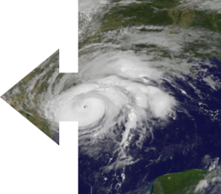
MPT Exception for Contingency Operations
To support contingency ops or facilitate defense against or recovery from cyber, nuclear, biological, chemical, or radiological attack.
MPT is $20,000 if awarded and performed,
or if purchase to be made INSIDE the U.S.
MPT is $35,000 if awarded and performed,
or if purchase to be made OUTSIDE the U.S.
INCLUDES: (1) Requests from the Secretary of State or Administrator of the USAID for international disaster assistance pursuant to 22 U.S.C. 2292, et seq.; or (2) Support response to an emergency or major disaster pursuant to 42 U.S.C. 5122 as described in FAR 13.201(g)(1), excluding construction subject to Wage Rate Requirements (Construction) (41 U.S. C. 1903).
Notes:
There is a micro-purchase threshold exception for contingency operations.
In FY98, the Stafford Act increased the MPT for use under contingency operations. Contingency operations include the acquisition of supplies or services that, as determined by the head of the agency, are to be used to support a contingency operation or to facilitate defense against or recovery from cyber, nuclear, biological, chemical, or radiological attack, international disaster assistance, and emergency or major disaster.
Excluded from these higher thresholds, however, is construction subject to the Wage Rate Requirements (Construction) statute we discussed earlier on the slide for MPT exceptions for construction.
The micro-purchase threshold for both civilian and military agencies is —
$20,000 in the case of any contract to be awarded and performed, or purchase to be made, inside the United States and
$35,000 in the case of any contract to be awarded and performed, or purchase to be made, outside the United States.
Purchases using this authority must have a clear and direct relationship to the support of a contingency operation. Typically, the Head of the Agency, or their delegated authority such as a Senior Procurement Executive, will define the contingency operation in writing and provide parameters for the use of the purchase card.
International disaster assistance is at the request of the Secretary of State or the Administrator of the United States Agency for International Development (USAID).
As we have seen, emergencies may include things such as the COVID-19 pandemic response or other declared emergency by the President of the United States.

Slide 29
Methods of Use (FAR 13.301)
Within the confines of the MPT and the authority of the account holder, purchase accounts can be used as…
Procurement Mechanism
Acquire and pay for goods and services by means other than use of an existing contract.
(i.e. Open Market)
Ordering Mechanism
Order goods and services under an existing contract only if authorized in the contract itself.
Payment Mechanism
Pay for goods and services when the contractor agrees to accept contract payment(s) using the card.
Notes:
METHODS OF USE (FAR 13.301)
The purchase card can be used in three ways, depending on the value of the transaction and the authority of the account holder.
Procurement Mechanism: The card may be used as a procurement tool to acquire and pay for goods and services by means other than the use of an existing contract (to make micro-purchases).
Ordering Mechanism: The card may be used to place a task or delivery order for goods and services if authorized in an existing contract like a GSA schedules contract or an agency’s IDIQ.
Payment Mechanism: The card may be used to make payments for goods and services when acquired by other means, such as a through a contract.

Slide 30
Uses Under/Over the MPT (FAR 13.301)
MPT | Who | Procure | Order | Pay
< or = MPT | All Account Holders | Yes | Yes | Yes
> MPT | Account Holder who is also a Contracting Officer/Ordering Officer (for orders) or Payment Official (for payments) | No ¹ | Yes ^{2&3} | Yes ⁴
¹ Transactions over the MPT must comply with applicable Federal procurement laws, regulations, and agency policies (i.e. public notification, competition, selection, etc.).
² Both the account holder limit AND the Contracting Officer/Ordering Officer authority (warrant) limit applies to the transaction. (EX: Unlimited Warrant & a single transaction limit of $250,000, orders cannot exceed $250,000.)
³ Certification of funds availability is required prior to making the purchase.
⁴ Exceptions for cards used solely for contract payments.
Notes:
Let’s take a look at this chart to see some purchase account uses at or below the micro-purchase threshold and over the micro-purchase threshold (FAR Subpart 13.301)
For transactions at or below the micro-purchase thresholds for supplies, services, and construction - as we previously discussed – account holders may use their cards as procurement, ordering, and payment mechanisms within their single and monthly transaction limits.
For actions valued over the micro-purchase thresholds for supplies, services, and construction, the procurement mechanism may not be used.
For actions valued over the micro-purchase thresholds for supplies, services, and construction, only account holders who are Warranted COs and Ordering Officers may use the ordering mechanism to place task or delivery orders against existing contracts if use of the purchase card is authorized in the basic contract terms and conditions (ORDERING MECHANISM).
For actions valued over the micro-purchase thresholds for supplies, services, and construction, only account holders who are Warranted COs and Payment Officials may use the payment mechanism to make payments on purchase orders, task/delivery orders or contracts where the purchase card is accepted as a form of payment (PAYMENT MECHANISM).
REMEMBER: The Contracting Officer/Ordering Officer/Payment Official authority limits and account holder single purchase limits apply. For example, if a Contracting Officer holds a $10M warrant and has a purchase card with a $250K single purchase limit, they may only place an order or may a payment using their purchase card up to the $250K single purchase limit. The account holder is held to the lower of their two limits.
COs must comply with all federal procurement laws and agency regulations and policies when using the card. Account holders who are also COs or Ordering Officers are not exempt from normal procurement processes simply because they hold the purchase card. This includes the need to issue a formal written purchase order/contract, requirements for publicizing purchases, acquisition planning, and comply with other FAR, agency, and local policies.
Also, please note the following about PAYMENT OFFICIALS: Some agencies have individuals that hold “payment cards” for the sole purpose of making payments under established contracts. The dollar values for those persons should be delegated by the Contracting Office or Chief Financial Officer and the single purchase limit for those account holders may be higher than the typical card holder, in accordance with agency policies.

Slide 31
Micro-Purchase Mythbusting
OMB Circular A-123 Appendix B, Section 3.7 & FAR Subparts 6.001, 8.405-1, 8.405-2, 9.104-7 and 13.301.
FAR requirements that do not apply at or below the MPT include:
Do Not Pay List.
System for Award Management (SAM).
Representation/Certification of Corporations Regarding Delinquent Tax Liability or Felony Conviction.
Written Quotes.
Competition (instead, rotate vendors).
Notes:
Before we go further, we get a lot of emails asking us if various FAR requirements apply to micro-purchases. Here are a few of the most frequently asked questions.
Does the Do Not Pay (DNP) List apply to micro-purchases? No, it does not. The DNP is a list of entities or people maintained by the Bureau of the Fiscal Service who should not be paid. This list assists agencies to prevent improper payments, fraud, waste, and abuse. Due to the low level of correlation between the DNP List and the merchants from which the Federal Government typically makes micro-purchases, there is no need to check the DNP List prior to making micro-purchases.
Does the System for Award Management (SAM) registration apply to micro-purchases? No, it does not. In accordance with FAR Subpart 4.1102, contractors ("merchants") from which purchases are made under the MPT using a purchase card do not have to be registered in the SAM.
For micro-purchases, do you have to require offerors to certify that their corporation does not have a delinquent tax liability or felony conviction? No, you do not. So, the FAR does have a provision (52.209-11) that requires offerors to certify that they are a corporation that does not have a delinquent tax liability or felony conviction, making them otherwise ineligible to receive an expenditure of federal funds. However, since micro-purchases do not use any formal solicitation procedures for procurement on the open market (i.e., we’re not using Request for Quotes (RFQs) or Request for Proposals (RFPs)), it is not applicable to micro-purchases.
Are Written Quotes required for micro-purchases? No. There is no requirement to obtain a written quote for a micro-purchases. It really can and should be as simple as calling a vendor, explaining what you need or providing a part number, possibly providing a simple statement of work or specification, and asking for a price over the phone. Agencies have different ways of documenting that process but written quotes from the vendor are not required.
Does Competition apply to micro-purchases? No. FAR Part 6, Competition Requirements, tells us that competition does not apply to acquisition of products and service when using FAR Part 13, under which micro-purchases fall (FAR Subpart 13.301). However, account holders should always rotate orders with vendors who can provide the products or services within the timeframe required. And, when ordering at or below the MPT using GSA Schedules, FAR Subpart 8.405-1 and -2 reads, “ordering activities may place orders…with any Federal Supply Schedule contractor that can meet the agency’s needs. Although not required to solicit from a specific number of schedule contractors, ordering activities should attempt to distribute orders among contractors.”

Slide 32
Required Sources - FAR 8.002(a)(1) & (2)
Sources (Consider in Numerical Order) | Supplies | Services
Inventories of the requiring agency (FAR 8.002(a)(1)(i)) | 1
Excess from other agencies (FAR 8.103) | 2
Federal Prison Industries (FPI) (operates under the trade name UNICOR) (FAR 8.603) www.unicor.gov | 3 | 2
AbilityOne (includes National Industries for the Blind (NIB) and SourceAmerica jointly) – supplies and services found on the Procurement List (FAR 8.704) www.abilityone.gov/procurement_list/index.html | 4 | 1
Wholesale supply sources, such as stock programs of GSA, DLA, VA (FAR 8.002(a)(1)(v)) | 5
Commercial Sources | 6 | 2
Notes:
When trying to determine a source for the purchase, many considerations must be made.
The Federal Acquisition Regulation - specifically (FAR) Subpart 8.002(a)(1)&(2) - outlines mandatory sources for supplies and services in their descending order of priority – which is listed here on the table. This table is sometimes called “the order of priority” and should be used unless otherwise provided by law or by the Head of the Contracting Activity (which is usually your Senior Procurement Executive, or SPE).
Let’s take a look at the “order of priority” for SUPPLIES:
Let’s say you are asked to purchase an executive desk chair. What steps do you take to determine from which source you should purchase the chair?
(1) First look the existing inventory of the agency to see if there is a chair that can meet your needs.
(2) If there is not a chair available within the agency, then look to excess inventories at other agencies for a suitable chair to meet your needs.
(3) If a chair meeting your needs is not found through the use of excess inventories, then look to UNICOR to meet your needs.
(4) If UNICOR cannot meet your needs or delivery requirements, then check the Government’s Procurement List managed by AbilityOne for products from participating non-profit agencies.
(5) If a chair meeting your needs cannot be found through an AbilityOne participating nonprofit agencies, then look to purchase from wholesale supply sources such as GSA, DLA, or VA stock programs.
(6) After consideration has been made to the previous sources, you may purchase from a commercial source.
And, now let’s take a look at the “order of priority” for SERVICES:
Similar steps are taken for services, which you can see on the right-hand column – First, you go to AbilityOne, then you may go to UNICOR or commercial sources as your second priority.
There are a few exceptions to consider when using the mandatory sources for things like utility services, printing and/or printing supplies, leasing vehicles, strategic and critical materials (e.g., metals and ores) from inventories exceeding Defense National Stockpile requirements, and helium. Exceptions can be found in FAR Subpart 8.003 – you can go there for additional guidance on these items.
Also when considering services to be performed by UNICOR, do not disclose information considered classified or that provides maps, drawings, or other information about the layout of government facilities.
To access the Procurement List for the latest information on items/services that must be procured through mandatory sources, go to the abilityone.gov site.

Slide 33
Section 508 of the Rehabilitation Act
OMB Circular A-123, Appendix B, Chapter 9.
Applies to Information and Communication Technology (ICT) purchases.
Account holders making purchases subject to 508 requirements should:
Understand Section 508 responsibilities.
Spend a reasonable amount of time on market research.
Consider the degree of risk for accessibility.
Use available tools and resources.
The Accessibility Requirements Tool (ART) can be found at app.buyaccessible.gov/.
Check out the U.S. Access Board at access-board.gov.
Notes:
Section 508 of the Rehabilitation Act is discussed in the OMB Circular. It requires that when Federal departments or agencies develop, procure, maintain, or use Information and Communication Technology (ICT) they must ensure that such ICT allows employees with disabilities to have access to and use of information and data that is comparable to other employees.
When making a micro-purchase of ICT, please make sure that the available accessibility information applies to the version of the product to be purchased. Account holders making these types of purchases should:
Understand Section 508 responsibilities.
Spend a reasonable amount of time on market research.
Consider the degree of risk for accessibility.
Use available tools and resources.
In the slide, I’ve also linked the Accessibility Requirements Tool (ART) and United States Access Board website, which can help with 508 compliance.

Slide 34

Sustainability/Environmental Consideration
OMB Circular A-123, Appendix B, Chapter 10.
Agencies are required to account for the sustainability of products procured with the purchase card.
Green Procurement Compilation (GPC) consolidates federal green purchasing information into one location.
Notes:
Agencies are required to account for the sustainability of products procured with the purchase card consistent with the requirements detailed in the OMB Circular A-123 and the FAR.
The Green Procurement Compilation (GPC) consolidates federal green purchasing information into one location, so please check that out when you have a moment.

Slide 35
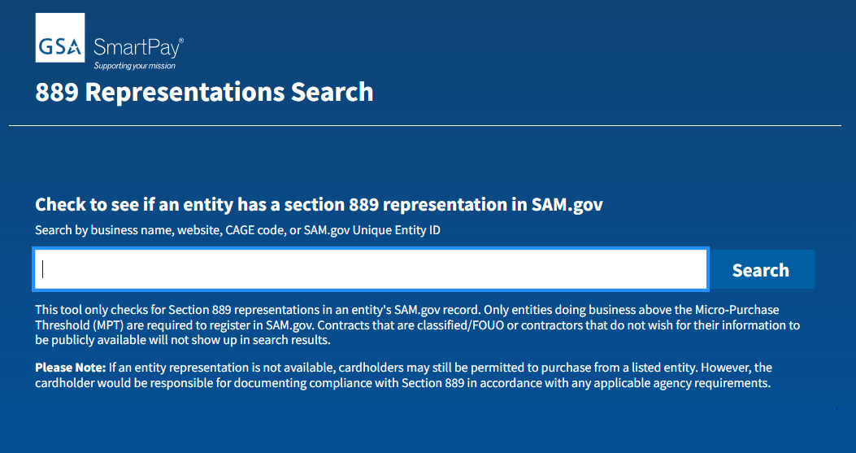
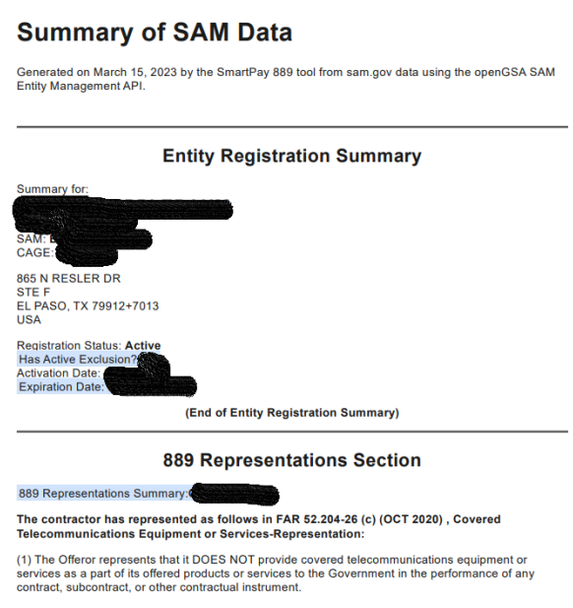
New 889 Search Tool
Protect your agency by checking the prohibited vendor list before making any telecommunications purchases.
Easy to use search tool.
Search by vendor name, website, CAGE code or UEI code.
Provides PDF if registered in SAM.gov.
Visit www.smartpay.gsa.gov.
Check out Smart Bulletin 33.
Notes:
889 compliance has become a hot topic over recent years.
The Federal Acquisition Regulation (FAR) case 2018-017 prohibits the purchase of covered telecommunications equipment and services from vendors who sell products containing spyware. These devices could pose a threat to U.S. security by spying on or disrupting communications within the U.S.
Section 889 was implemented as part of the fiscal year 2019 National Defense Authorization Act. It contains two parts. Part A includes language that prohibits the government from obtaining equipment and services from a defined list of covered entities. This part is applicable to purchases including commercial items and micro-purchases. Part B focuses on language related to prohibition of entering into contracts with covered entities. It is applicable to all contracts, regardless of dollar value or sector.
Vendors are required by the FAR to provide information on whether or not they are providing covered telecommunications under contracts and orders with the Federal Government.
Our office has a new 889 tool that will go live on www.smartpay.gsa.gov around the end of this fiscal year.
The tool will help your agency because it will be an easy way to check to see if a vendor is in compliance with Section 889 before you make a purchase. Once you go to the tool, you’ll enter vendor information such as their name, website, Commercial and Government Entity (CAGE) code or Unique Entity ID (UEI). The tool will provide you the vendor’s 889 Representations Summary based on their System for Award Management (SAM) record at www.SAM.gov.
Please note: If a vendor’s representation is not available, account holders may still be permitted to purchase from a listed vendor. However, the account holder is responsible for documenting compliance with Section 889 in accordance with any applicable agency requirements.
You can read more about card management implications and information for agency consideration in relation to the Section 889 Prohibition on Acquiring Certain Telecommunications and Video Surveillance Equipment in Smart Bulletin 33, which is available at www.smartpay.gsa.gov.

Slide 36
Convenience Checks
Intended only for the use of authorized purchases with merchants that do not accept other forms of payment, such as a GSA SmartPay purchase card.
Provide thieves with an easy way to commit fraud.
Do not offer the same kinds of consumer protections that other GSA SmartPay solutions offer.
Deducted from total agency spend when calculating refunds.
Agencies are charged a fee for each check written.
Notes:
HOW CONVENIENT ARE CONVENIENCE CHECKS? The answer is NOT VERY. :)
Convenience checks are a payment and/or procurement tool intended only for the use of authorized purchases with merchants that do not accept other forms of payment, such as a GSA SmartPay purchase card. Convenience checks should be used as a payment method of last resort, only when no reasonable alternative merchant is available who accepts a GSA SmartPay purchase account.
Please keep a few things in mind when using convenience checks. They provide thieves with an easy way to commit fraud and they don’t offer you the same kinds of consumer protections that other GSA SmartPay solutions do.
Due to the nature of this product, additional care should be taken in managing accounts with the convenience check feature:
Checks should be secured at all times to ensure against physical theft. Checks are to be stored in a locked container, such as a safe or metal filing cabinet. Checks should be accounted for appropriately to prevent loss, theft or potential forgery.
The number of accounts and checks on hand should be limited to reduce risk.
The A/OPC is responsible for the implementation of the appropriate internal controls and oversight of convenience check activity, including ensuring that all checks issued are for official government business only.
Furthermore, convenience checks are deducted from total agency spend when calculating refunds. Agencies are charged a fee for each check written. So, they reduce refunds and increase fees to the agency.

Slide 37
Convenience Checks
Do not use Convenience Checks:
If the vendor otherwise accepts the purchase card.
To pay for modifications to work under another method of acquisition.
To reimburse an employee.
For cash advances, salary payments, cash awards, or any transaction processed through the payroll system.
For travel-related transportation tickets (air, bus, rail, boat) or meals and/or lodging while an employee is on travel except as related to emergency incident response.
For any other restricted purchase as determined by agency policy.
Notes:
….And, as a reminder, do NOT use convenience checks:
If the vendor otherwise accepts the purchase card.
To pay for modifications to work under another method of acquisition.
To reimburse an employee.
For cash advances, salary payments, cash awards, or any transaction processed through the payroll system.
For travel-related transportation tickets (air, bus, rail, boat) or meals and/or lodging while an employee is on travel except as related to emergency incident response.
For any other restricted purchase as determined by agency policy.

Slide 38

Recurring Payments
General Rule: If the aggregate total of the payments over a 12-month period (or less if the contract duration is shorter) does not exceed the single transaction limit of the account holder, the purchase card may be used.
Scenario: An account holder has a single transaction limit of $10,000. The account holder is asked to make fifteen (15) equal monthly payments totaling $12,000 on an order. Can they make the recurring payments using the purchase card?
YES!
$12,000 / 15 = $800
$800 x 12 = $9,600
$9,600 < $10,000
Notes:
Let’s touch on recurring payments.
The general rule of thumb is that when you have recurring payments you may use the purchase card to make those payments if the aggregate total of the payments over a 12-month period (or less if the contract duration is shorter) does not exceed the single transaction limit of the account holder. Again, Payment Officials who are delegated higher authority for payment purposes will be subject to the policies of the agency in that case.
Let’s discuss a scenario:
An account holder has a single transaction limit of $10,000. The account holder is asked to make fifteen (15) equal monthly payments totaling $12,000 on an order. Can they make the recurring payments using her purchase card? YES!
Dividing $12,000 by 15 months we get a monthly payment amount of $800. Taking $800 x 12 months = $9,600, which is less than the account holder’s single transaction limit of $10,000. They can make the payments with their purchase card.
Also, please note: Do not split payments to a single vendor between account holders to circumvent the 12-month recurring payments guidelines.

Slide 39
Split Purchases
Dividing a single transaction into two or more smaller transactions to stay under the MPT or single transaction limit.
Scenario: An account holder has a single transaction limit of $10,000. The account holder needs to purchase a flat-bed trailer for a strategic customer with delivery required within 48 hours. The total cost is $12,000. The account holder calls the vendor, who has one trailer in stock for delivery tomorrow. The account holder is crunched for time, so they ask the vendor to charge their card $10,000 today and $2,000 tomorrow to complete the purchase. Is this a split purchase?
YES!
Notes:
What is a split purchase? Splitting purchases is a prohibited practice with the card. This occurs when a single transaction is broken down in two or more smaller transactions to circumvent the account holder’s single transaction limit or to stay under the MPT.
Account holders and approving officials that participate in split purchases may have their cards revoked and face disciplinary action.
Let’s discuss a scenario. An account holder has a single transaction limit of $10,000. The account holder needs to purchase a flat-bed trailer for a strategic customer with delivery required within 48 hours. The total cost is $12,000. The account holder calls the vendor, who has one trailer in stock for delivery tomorrow. The account holder is crunched for time, so they ask the vendor to charge their card $10,000 today and $2,000 tomorrow to complete the purchase.
Is this a split purchase? YES, this is a split purchase and a real life example! In this case, the Project Manager ended up suspended for 14 days for improper use of the card and the Requestor (Customer) was reprimanded for their involvement by submitting separate budget requests. So, please caution your account holders against this type of practice.

Slide 40

Tax Exemption and Surcharges
Tax Exemption
Purchase Cards are centrally billed accounts (CBAs) and are exempt from sales taxes in all 50 states and U.S. territories
Some states require tax exemption forms.
Visit smartpay.gsa.gov and click on the SmartTax icon for more information.
Surcharges
May be assessed by a retailer and added to the cost of a purchase.
Surcharges should be disclosed in advance and itemized on the receipt.
Several states do not allow or limit use of surcharges.
See GSA SmartPay® Smart Bulletins 17 and 20 for more information.
Notes:
Tax exemption and surcharges! Always popular topics.
Another presentation plug - Allow me to quickly mention that the GSA SmartPay team offers a full class on taxes, so you may want to check out that class during the forum if your schedule allows.
So, all Purchase Card accounts fall into the category of Centrally Billed Accounts (CBAs) for which the customer agency/organization is directly billed and liable for making the payment. As such, transactions under the purchase card are exempt from sales taxes in all 50 states and U.S. territories. Some states still require a form to be completed for such an exemption.
Vendors are expected to collect tax in accordance with established State tax laws and regulations. However, laws may change very suddenly and merchants and vendors rely on point of sale employees, who may not have updated information. Merchants and vendors may choose to err on the side of caution and assess taxes even for CBA cards. When a merchant is in doubt, account holders are encouraged to ask merchants to contact the applicable State taxation authority for clarification prior to completing the purchase.
While sales tax is exempt in all states and U.S. territories for purchase cards, some states may have other taxes which the government is subject to pay. So, just be aware that there are other kinds of taxes out there that may apply to purchase card transactions.
If you ever have tax related questions, please go to our website - smartpay.gsa.gov - and click on the SmartTax icon which you see in the center of the slide for more tax information.
SURCHARGES:
Surcharges may be assessed on purchases, depending on the vendor. A Surcharge is a fee added to the cost of purchase assessed by the retailer to compensate the retailer for the customer’s use of a charge/credit card. Not all vendors will impose a surcharge. Several states do not allow or limit surcharges and Visa and Mastercard have strict guidelines for the assessment of surcharges. Generally the surcharge is capped at 4% of the total transaction amount but some states have additional caps and guidelines.
For a comprehensive list of tax information and to view the GSA SmartPay Smart Bulletins that apply to taxes and surcharges, again, see the smartpay.gsa.gov website.

Slide 41
Third Party Payment Processors
Third Party Payment Processors are non-bank entities that provide payment processing services to merchants.
GSA SmartPay® Smart Bulletin 23 (updated August 2021) “...if a merchant is well known or there is prior purchase history with the merchant, third party payment methods can be safe. Cardholders should still ensure any processing terms and conditions remain advantageous to the Government.”
Notes:
Third Party Payment Processors are non-bank entities that provide payment processing services to merchants. Examples include Apple Pay, PayPal, and Square, among others.
Although there are no existing government-wide policies or procedures outlining the use of third party payment processors, several agencies have developed internal policies related to this issue. These policies range from the complete restriction of third party payment processors to less restrictive policies which allow for transactions to be made when a workaround cannot be identified.
GSA’s Smart Bulletin 23 suggests that each agency/organization develop and issue internal guidance for the use of third party payment systems.
Agencies may want to consider the following potential issues regarding use of third party payment processors:
Account holders are prohibited to establish accounts or agree to commercial terms and conditions of third party payment processors without consent from their legal counsel or other proper authority.
There may be limitations to account verification with the third party processor.
In some instances, when using a third party payment process, the dispute process may differ greatly.
A third party processor may use a truncated merchant name that may create difficulty for reporting, reconciliation, and oversight purposes.
There is often less Level II and Level III transactional data available when utilizing a third party payment processor. The account holder may only receive the merchant name and dollar amount of the transaction when making a purchase with a third party payment processor.
So, please keep all of this in mind when creating your agency’s third party payment processor policy.

Slide 42
Disputing Transactions
Unauthorized or incorrect charges.
Charges for merchandise that has not been received.
Charges for returned merchandise.
Statement does not include credits issued to the account holder.
Disputes must be reported to the bank within 90 days from the date the transaction was processed or disputes rights are lost.
Information can be found in the GSA SmartPay 3 Master Contract, Section C.3.3.14.1, Billing Discrepancies.
Notes:
Of primary importance is the need to understand the Government has the right to dispute transactions. There are various reasons for disputing transactions, including:
Unauthorized or incorrect charges.
Charges for merchandise that has not been received.
Charges for returned merchandise.
Statement does not include credits for which the account holder has been issued.
In most cases, the account holder should contact the merchant directly to resolve any disputed charges and request a credit from the merchant. If the account holder and merchant are unable to resolve the dispute, the account holder can dispute a charge by visiting the contractor bank’s website, contacting the bank’s customer service number, or through the bank’s electronic access system (EAS). The account holder will have to provide information including the account number, transaction date, merchant name, transaction amount, account holder signature, and a detailed explanation of the dispute.
All disputes must be reported to the bank within 90 days from the date the transaction was processed.

Slide 43
Recordkeeping and Retention
GSA SmartPay® Smart Bulletins 25 and 28
FAR Subpart 4.703 – Contractor Records Retention, Policy
Office of Management and Budget (OMB) Circular A-123, Appendix B, Improving the Management of Government Charge Cards (as revised)
National Archives and Records Administration (NARA), General Records Schedule (GRS), Transmittal 23 (Sep 2014) -- GRS 1.1, Financial Management and Reporting Records
Notes:
All the key players in the purchase card program should understand the importance for supporting documentation and the requirements for records management as it relates to the use of the GSA SmartPay purchase card.
Records include all transaction-related documentation such as: documentation pertaining to the preapproval to make a purchase card transaction, if and when such pre-approval is required by the account holder’s agency/organization policy; contractor quotes, invoices, documentation of approval and acceptance, funding information, etc. What, how, and where this information is housed is based on the agency/organization policies.
A/OPCs should become familiar with the references listed on this slide, which involve recordkeeping and records retention.

Slide 44
Misuse and Fraud
Notes:
During this part of the presentation, we will review information on how you can minimize the risk of misuse or fraud in your GSA SmartPay purchase program. The most important thing you can do is to be aware of what activity is occurring on the accounts under your purview. Do not be afraid to ask questions if you identify unusual or suspicious transactions or behavior.

Slide 45
Misuse/Abuse
Common examples:
Purchases exceed the authorized limit.
Purchases for which no funding is available.
Allows others to use his/her purchase account.
Split Transactions.
Products or services that do not meet the government's requirements.
Purchases for personal consumption.
Purchases that are not authorized by the agency/organization.
Notes:
Minimizing risk is very important. Misuse/Abuse can take many different forms, but here are some of the most common examples:
Purchases exceeding the authorized limit. Accounts may be limited to a specific spending limit per transaction, per day, or per monthly billing cycle.
Purchases for which no funding is available. Federal law requires that funds must be available before any government purchase is made.
Account holders must take steps to ensure the security of their account. This means the purchase account must be used only by the account holder and only for official government business. If the account holder allows others to use the purchase account, the account holder will be held personally liable to the Government for any unauthorized transactions.
Split Transactions. The FAR limits the dollar threshold for micro-purchases. Any purchase that, as a whole, would exceed the micro-purchase limit but is separated into smaller transactions in order to avoid the micro-purchase limit is considered to be a split transaction.
Products or services that do not meet the government's requirements. Account holders must use discretion when making purchases to ensure that they meet the government's requirements. Due to the wide array of products and services available, there may be occasions when account holders may be requested or tempted to buy luxury or deluxe versions of products and services that exceed the government's actual requirements. For instance, it would be questionable for an account holder to buy a $500 designer fountain pen when there are many quality fountain pens available for $50 or less.
Purchases for personal consumption. All purchases must be for official government use only. Thus, any purchase made that is for the account holder's personal use rather than for official government purposes is considered to be misuse. For example, an account holder who uses the purchase account to buy himself lunch at the gas station because he had no cash available that day is misusing the account.
Purchases that are not authorized by the agency/organization. Your agency/organization may have additional limits on the use of the account, such as limiting certain categories or types of products or services.

Slide 46
Suspected Misuse/Abuse
If a situation occurs where you must report suspected misuse:
Contact the account holder.
If you still have questions, compile all the information (e.g., statement, exception report, documented contacts between you and the account holder, copies of receipts, etc.) before you report it.
Report to all required parties.
Notes:
Please keep in mind that misuse by employees impacts agency/organization charge card performance and refund earning potential. A key responsibility for most program coordinators is to detect and report suspected misuse. If a situation occurs where you must report suspected misuse, make sure you have all the information necessary to assist with a formal inquiry or investigation. Contact the account holder to obtain any information that could explain questionable charges. If the account holder provides documentation or an explanation regarding the charges and you still have questions or concerns about it, compile all the information (such as the statement, exception report, documented contacts between you and the account holder, copies of receipts, etc.) before you report it. Your agency/organization may ask you to report suspected misuse to one or more of the following personnel:
The Approving Official
The Finance Officer
The Office of Inspector General (via the hotline) or the Office of Special Investigations (for Defense agencies)

Slide 47
Consequences
Reprimand.
Counseling.
Suspension of employment.
Termination of employment.
Criminal prosecution.
Note: Some agencies have agency-specific penalties and consequences for misuse/abuse of the purchase account.
Notes:
Consequences for misuse/abuse may include:
Reprimand.
Counseling.
Suspension of employment.
Termination of employment.
Criminal prosecution.
Please note that some agencies have agency-specific penalties and consequences for misuse/abuse of the purchase account.

Slide 48

Fraud
Fraud is a deception deliberately practiced with the motive of securing unfair or unlawful gain.
Notes:
Fraud is a deception deliberately practiced with the motive of securing unfair or unlawful gain.
Fraud can be an attempt to cheat the Federal Government and corrupt its agents by using GSA SmartPay payment solutions for transactions that are not part of official government business. Like any deception, fraud has its fair share of victims.

Slide 49
Fraud
Types:
Counterfeit Accounts
Lost or Stolen
Non-Receipt
Card Not Present
Phishing
Identity Theft
Notes:
Some of the different types of fraud include:
Counterfeit Accounts — To make fake cards, criminals use the newest technology to “skim” information contained on magnetic stripes of cards.
Lost or Stolen Accounts — Often physical cards are stolen.
Non-Receipt Fraud — This occurs whenever new or replacement cards are mailed and then stolen while in transit.
Card Not Present (CNP) Fraud — Card Not Present fraud can occur when account information is stolen and used to make online purchases. Usually, a merchant will ask for the CVC code (located on the back of the card itself) to help prevent this type of fraud.
Phishing — Phishing occurs whenever an account holder receives a fake email directing him or her to enter sensitive personal information on a phony website. The false website enables the criminal to steal information from the account holder.
Identity Theft Fraud — Whenever a criminal applies for an account using another person’s identity and information.

Slide 50
Fraud
As a Program Coordinator, you must inform your account holders to:
Be alert to the indicators of fraud.
Report suspected fraud immediately through the proper channels at your agency.
Notes:
As a program coordinator, you must inform your account holders to:
Be alert to the indicators of fraud such as false charges, mischarging, bribes, gratuities, and kickbacks.
Report suspected fraud immediately through the proper channels at your agency which may include the AO, Financial Officer, Office of the Inspector General or Office of Special Investigations.

Slide 51
Tools to Reduce Misuse/Fraud
Program Management Tools:
Implement Credit limits.
Use Merchant Category Code (MCC) Blocks.
Review Online Reports.
Deactivate Accounts.
Guides.
Notes:
Always follow your agency's policies and procedures when handling cases of suspected misuse and fraud.
Here are some program management tools that can help you to reduce fraud:
Credit limits - Credit limits restrict single, daily, weekly, or monthly expenditures per account. In accordance with agency/organization policy, an A/OPC may set the limits which best meet the agency's needs. Setting limits that are realistic, but not excessive, will deter misuse. By reviewing spending patterns, you may be able to lower limits without disrupting the agency's mission. A/OPCs also have the authority to raise limits at any time in response to emergency or unforeseen situations.
Merchant Category Code (MCC) Blocks - Merchant Category Codes (MCCs) are established by the associations or contractor banks to identify different types of businesses. Merchants select the codes that best describe their business. You may limit the types of businesses where the account will be accepted by limiting the MCCs available to the account holder. The contractor bank has established sample templates that may assist you in determining which MCCs should be restricted. In the event that an account needs to make a purchase outside of his/her restricted MCCs, A/OPCs are authorized to override the restriction for a transaction by contacting the contractor bank's Customer Service Representative. Agency/organization policy should specify who is authorized to perform overrides.
Online Reports - A/OPCs have access to many standard and ad hoc reports online through the contractor bank’s EAS.
Account Deactivation - In those instances when the purchase account is not needed on a continuous basis, deactivation of the account may serve as a deterrent to fraud and/or misuse. You may deactivate the account when an account is not being used. By understanding the use of the account, you can establish deactivation guidelines. Deactivation and reactivation can be completed through the bank's EAS or by calling the bank's customer service phone number.
5. Guides - The banks have developed written guides for A/OPCs and account holders, so reach out to the banks if you’d like to view them.

Slide 52
Tools to Reduce Misuse/Fraud
Purchase A/OPCs can:
Establish policies and procedures to detect fraud, waste and abuse.
Emphasize standards of conduct and clearly state consequences for misuse.
Manage delinquency and implement proper training.
Notes:
In addition, purchase program coordinators can:
Establish policies and procedures to detect fraud, waste and abuse.
Emphasize standards of conduct and clearly state consequences for misuse.
Manage delinquency and implement proper training.

Slide 53
Best Practices
Notes:
During this part of the presentation, we’ll talk about some best practices for your consideration. Each agency runs their charge card program a bit differently. But, perhaps you’ll find some of these ideas and suggestions helpful as you learn to manage your charge card program.

Slide 54
Best Practices - Suggestions
Train account holders on the proper use of the purchase account. Use ethics training as another source for instruction.
Develop a purchase hotline to respond to account holder questions.
Develop and maintain a purchase-specific website for your agency.
Create a monthly newsletter for agency purchase policies and procedures.
Notes:
Good training and communication with your account holders is key!
Train account holders on the proper use of the purchase account. Use ethics training as another source for instruction.
Develop a purchase hotline to respond to account holder questions.
Develop and maintain a purchase-specific website for your agency.
Create a monthly newsletter for agency purchase policies and procedures.

Slide 55
Best Practices - Suggestions
Publish “Frequently Asked Questions” on the agency internal website.
Send periodic reminders on agency purchase policies and procedures.
Hold orientation sessions with new account holders.
Email updates to A/OPCs at all levels on program changes.
Perform annual review.
Notes:
Publish a “Frequently Asked Questions” page on the agency internal website.
Send periodic reminders on agency purchase policies and procedures.
Hold orientation sessions with new purchase account holders.
E-mail updates to A/OPCs at all levels on important program changes.
Consider performing an annual review of all issued accounts to determine whether each account meets the criteria for continued participation in the Federal Government purchase program.

Slide 56
Best Practices - Reporting
A/OPCs have access to reports to manage your purchase program effectively through your bank’s Electronic Access System (EAS).
A/OPCs should reach out to your bank for User ID/password.
EAS allows for the monitoring of account holder transactions at any time.
Notes:
Program Coordinators have access to a number of reporting tools that enable you to manage your purchase program effectively through your contractor bank's Electronic Access System (EAS). To access reports, contact your bank representative to obtain a User ID and password.
Each bank has a slightly different suite of reports available, so review the contractor bank's A/OPC guide or go online to learn about the specific reports offered. Most electronic reports are updated within two to three days after a transaction. However, some reports are only updated at the end of the billing cycle.
Program coordinators will also have access through the EAS to monitor account holder transactions at any time. By searching by account number, you can track transactions, as well as view monthly statements. You may also contact the bank’s customer service at any time to request information on a specific account.

Slide 57
Best Practices - Reporting
Take the time to understand all available reports.
Proactively review reports regularly.
Use exception reports to detect misuse of the purchase account or unusual spending patterns.
Use ad hoc reporting tools to customize and/or develop your own agency reports.
Save copies of all generated electronic reports, particularly statistical or summary reports.
Notes:
So, be sure to use the online tools provided by the banks, GSA, and your agency.
Take the time to understand all available reports.
Proactively review reports regularly to oversee the purchase account program’s financial condition, to monitor for fraud, waste, and abuse, and to track trends in delinquency rates and charge offs/write offs.
Use exception reports to detect misuse of the purchase account or unusual spending patterns.
Use ad hoc reporting tools to customize and/or develop your own agency reports and to eliminate manual calculations.
Save copies of all generated electronic reports, especially statistical or summary reports. Due to the volume of information available, the bank will furnish information for a limited period of time (generally, 18 months or less) before archiving the data. Reports containing sensitive information (like account numbers, account holder information, etc.) should be maintained in a secure location. Review and follow your agency/ organization policy for instructions on printing and safeguarding reports.

Slide 58
Resources
Notes:
And, in closing, as charge card managers, please continue to review the GSA SmartPay website, read the GSA SmartPay Master Contract, study your agency’s task order, attend the yearly GSA SmartPay Training Forum, and talk with your fellow A/OPCs to learn more about the GSA SmartPay program overall, as well as your agency’s specific charge card program policies.
Also, it is helpful to get to know your bank's Customer Service Representatives and Account Managers. They can provide a wealth of information and are ready and able to answer questions to help you manage your program. Many of your responsibilities as an A/OPC involve a working relationship with the contractor bank.
Before we go, I’d like to share a few resources with you.

Slide 59
Centralized Mail List Service (CMLS)
CMLS Information
Phone Number: (800) 488-3111 Email: ncsccustomer.service@gsa.gov Helpful Hints for Purchase Account Use
Notes:
Go to the Centralized Mail List Service (CMLS) to order hard copies of the GSA SmartPay guides and publications. Simply refer to the specific publication by title or document ID. Both printing and shipping is free for agency customers.
If you click on the CMLS Information link on this slide, you’ll learn more about this service. I’ve also provided the phone number and email here for you.
I’ve also linked the publication named the GSA SmartPay Helpful Hints for Purchase Account Use which is for federal civilian and military audiences. This mini-booklet contains the dos and don'ts for Purchase Account use, procedures for reporting a lost or stolen card, and bank resource information. So, you may want to provide this to your account holders.
Again after this presentation, it may be helpful for you to download this PowerPoint so that you can keep all of this information on hand.

Slide 60
Forum PowerPoints
Go to gsasmartpayforum.org.
Click on the “Presentations/CLPs” page.
Then, you’ll see how to access GSA PowerPoints, as well as bank/brand PowerPoints.
GSA PowerPoints are housed on smartpay.gsa.gov.
Notes:
And, how do you access the forum PowerPoint decks? If you’re interested in downloading the forum PowerPoints, they are another great resource to keep on hand. Just go to the forum website – gsasmartpayforum.org.
At the top of the screen, click on the “Presentations/CLPs” page.
Then, you’ll see links to the forum PowerPoints for the GSA presentations, as well as for the bank and brand presentations.
GSA PowerPoints for the forum are housed on our program website – smartpay.gsa.gov. And, later on after the forum’s event portal closes, you’ll likely see some of the training videos for the GSA classes on smartpay.gsa.gov. So, if some of your colleagues did not attend this year’s forum, they may be able to view some of the training videos later on after this event is over – however, they will not receive CLP credit like you are receiving today!

Slide 61
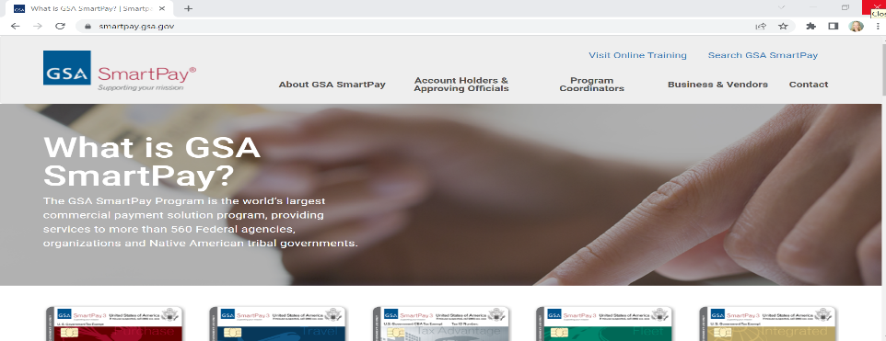
smartpay.gsa.gov
GSA SmartPay Program Website
Notes:
Here’s our program’s website that I mentioned throughout today’s presentation - smartpay.gsa.gov.

Slide 62
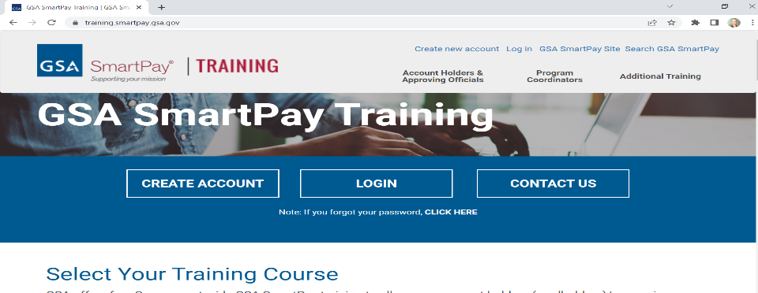
training.smartpay.gsa.gov
GSA SmartPay Training Website
Notes:
…and here’s our program’s training website - training.smartpay.gsa.gov.
The Center for Charge Card Management (CCCM) offers free online purchase card training for A/OPCs, as well as for account holders, at training.smartpay.gsa.gov.
To access the Purchase A/OPC training, click on “Program Coordinators”, then on “Purchase” from the drop-down menu.

Slide 63

GSA’s Center for Charge Card Management
gsa_smartpay@gsa.gov Monday – Friday 8:00 a.m. - 4:00 p.m. ET Excluding federal holidays
Notes:
Agencies, organizations, and account holders can also reach out to our team via email (gsa_smartpay@gsa.gov). Our inbox is staffed Monday – Friday from 8:00 a.m. to 4:00 p.m. ET with the exception of federal holidays. So, again, feel free to reach out to us. We are here to help!

Slide 64
Citibank
(800) 790-7206 (within United States)
(904) 954-7850 (collect calls from outside United States)
Citibank Online Account Access
Notes:
Here’s Citibank’s contact information.

Slide 65
U.S. Bank
(888) 994-6722 (within United States)
(701) 461-2232 (collect calls from outside United States)
U.S. Bank Online Account Access
Notes:
And here’s U.S. Bank’s contact information.

Slide 66

Contact Information
Rebekah Knouse Perillo rebekah.knouse@gsa.gov
Notes:
And, now we have reached the end of today’s GSA SmartPay Purchase Management Essentials presentation. I hope that you have found it useful and helpful and perhaps you’ve learned some new information. Again, my name is Rebekah Knouse Perillo and here is my email address - rebekah.knouse@gsa.gov. Feel free to reach out to me at any time if you have any questions. Thank you for your time and attention! Have a wonderful day!

Slide 67

GSA Starmark Logo

